Slide 1
Open Source Physically Based Rendering with appleseed
François Beaune
Project Founder
Notes:
Hi everyone!
Thanks for attending my talk, appreciated! I hope you’ll enjoy it.
My name is François Beaune,
I’m the founder of the appleseed project.

Slide 2
Fetch
appleseed
Notes:
My talk is split in two parts:
In the first part, I’ll explain what appleseed is and how it works in practice
In the second part, I’ll talk about Fetch, a short film we completed last year.
We should normally have time for questions at the end.

Slide 3
appleseed
Notes:
Alright, so let’s get started with appleseed.

Slide 4
appleseed
Open source rendering engine
Designed for VFX and animation
Targeted at individuals and small studios
Notes:
appleseed is an open source rendering engine
Specifically designed for visual effects and animation
That means:
Supporting large scenes
Lots of geometry
Lots of textures
Motion blur everywhere
Avoiding flicker at all costs
Nothing worse than debugging flickering in a heavy shot
Being reliable and flexible
Mainly targeted at individuals and small studios

Slide 5
appleseed
Started in June 2009
Small, professional team
Not our main job
Notes:
Started in 2009
As a reference: Cycles, the other animation- and VFX-oriented open source renderer, was started in 2011 (as far as I know)
We all work (or worked at some point) in the industry
We’re doing this in our free time
That’s the kind of things we like to do
Great excuse for many side projects such as animation shorts
Allows us to travel quite a bit
And to meet many many interesting people
So it’s a pretty cool hobby really

Slide 6
appleseed
Pure CPU renderer
Unidirectional path tracing
Physically-based
Highly programmable
Notes:
So, at this time, appleseed is a pure CPU renderer.
GPU rendering is certainly a thing, and might be faster
But there are many things that we want to do that cannot run on the GPU (today)
Still many graphics drivers / CUDA / OpenCL issues and other incompatibility problems
appleseed is mainly a unidirectional path tracer (like Solid Angle’s Arnold)
But it has other experimental engines such as light tracing or SPPM
We plan to implement and evaluate BDPT and VCM (we already have all the building blocks)
Physically-based lighting, shading, and cameras
Highly programmable (we’ll come back to this)

Slide 7
appleseed
LIGHT TRANSPORT
Distributed Ray Tracing
Unidirectional Path Tracing
Stochastic Progressive Photon Mapping
Light Tracing
RENDERING MODES
Multi-pass rendering
Progressive rendering
Interactive rendering
Scene editing during rendering
Spectral rendering (31 bands)
RGB rendering
Automatic spectral / RGB switching
CAMERA MODELS
Pinhole camera
Spherical camera
Thin lens camera (depth of field)
Polygonal diaphragm shapes
Image-based diaphragm shapes
LIGHT SOURCE MODELS
Point light
Spot light
Gobos
Directional/parallel light
Mesh light
Purely diffuse emission profile
Cone-shaped emission profile
Image-based lighting
Latitude-longitude environment maps
Mirror-ball environment maps
Preetham physically-based day sky
Hosek & Wilkie physically-based day sky
Physically-based sun
REFLECTION MODELS
Lambertian BRDF (purely diffuse)
Specular BRDF (perfect mirror)
Specular BTDF (clear glass)
Oren-Nayar Microfacet BRDF
Ward Microfacet BRDF
Blinn Microfacet BRDF
GGX Microfacet BRDF
Microfacet BTDF (rough glass)
Anisotropic Ashikhmin-Shirley BRDF
Kelemen BRDF
Disney's Layered BRDF
Arbitrary mixture of BRDFs
MOTION BLUR
Camera motion blur
Transformation motion blur
Deformation motion blur
Arbitrarily number of motion steps
PRODUCTION FEATURES
Open Shading Language
OSL shader library
Disney's SeExpr expressions
Rule-based render layers
Hierarchical instancing
Per-instance visibility flags
Alpha mapping
Automatic color space conversions
Ray bias
Light Near Start
Max Ray Intensity
Dozens of diagnostic modes
INTEROPERABILITY
Windows, Linux and OS X (64-bit)
OBJ, Alembic, BinaryMesh (proprietary)
OpenEXR, PNG
OSL shaders
Gaffer integration
Maya integration
Blender integration
HACKABILITY
Fully open source, MIT license
Very clean code
CMake build system
Full featured C++ API
Full featured Python 2.x/3.x API
More than 1200 built-in unit tests
Hundreds of built-in performance tests
Rich, automatic functional test suite
PERFORMANCE
Multithreaded, scalable
SSE / SSE2 vectorization
Memory-bounded texture cache
Multiple Importance Sampling
Efficient handling of alpha maps
TOOLS
Graphical tool for scene edition
Command line renderer
Dropbox-based render farm tools
OSL compiler and tools
Notes:
I’m certainly not going to go over all the features available in appleseed
As you can see there are many
A lot of them are typical features anyone would expect from a production renderer
The full list of features is available on our website (URL at the end)

Slide 8
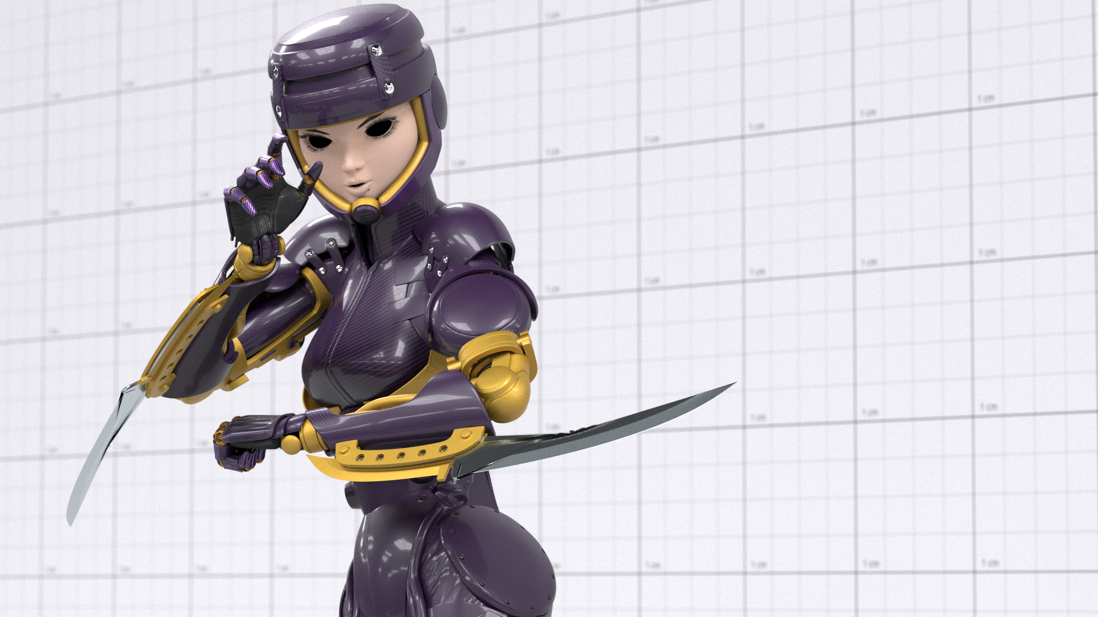
Notes:
So, instead, I’d rather show you appleseed in action.
Here is a model made by my good friend François Gilliot.
It’s a robot girl called Gally, from the manga ‘Battle Angel Anita’ (Gunnm in Japan, pronounced Ganmu)
Pardon the missing eyes and highly incomplete lookdev, the model is far from finished.

Slide 9
71.8 million triangles
2.4 GB of textures
Disney layered BRDFs
SeExpr expressions
Image-based lighting
Depth of field Average workstation Intel Core-i7 5820K (6-core) 16 GB of RAM
Notes:
So it’s a reasonably large model.

Slide 10
Notes:
(Video)

Slide 11
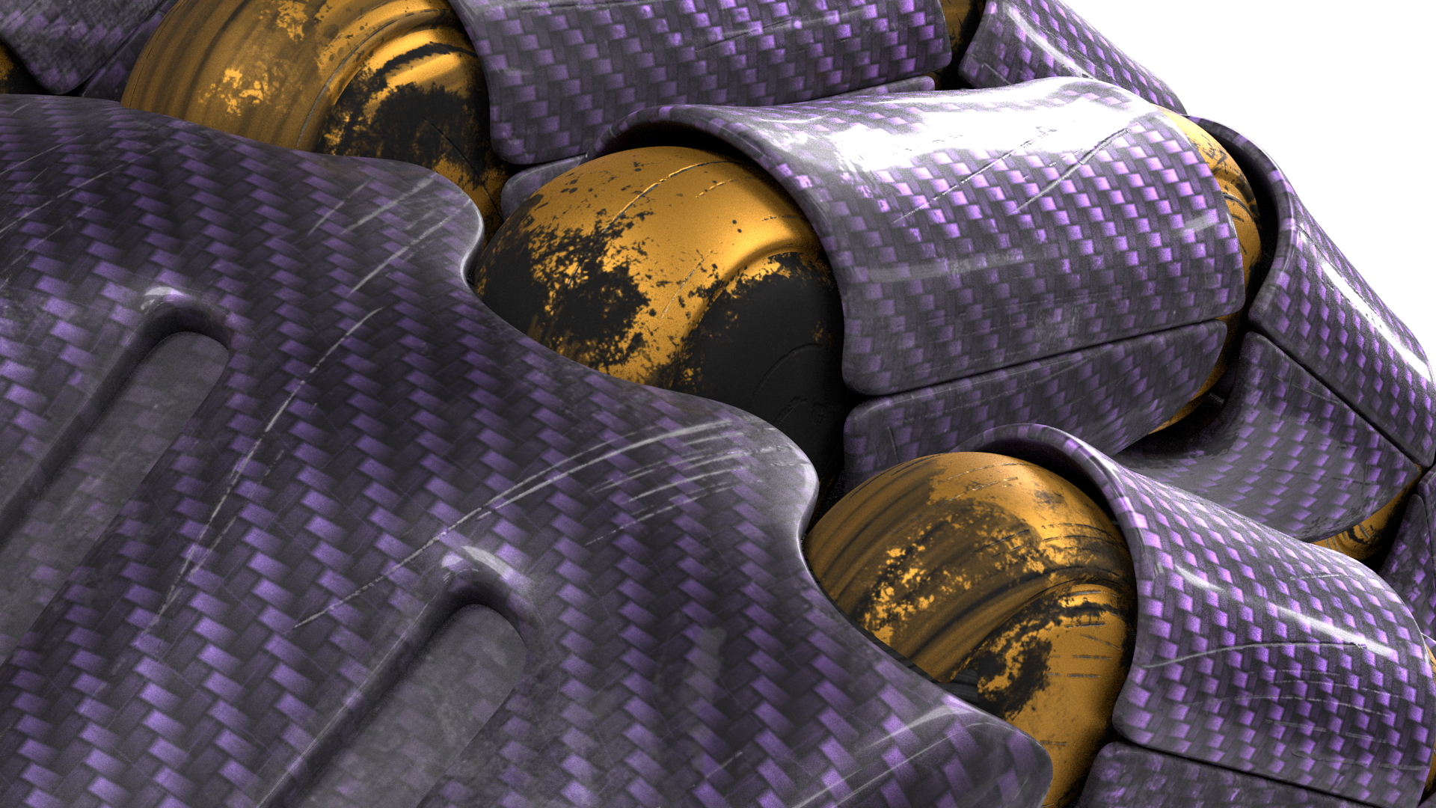
Notes:
Here is a converged closeup of the finger joints.

Slide 12
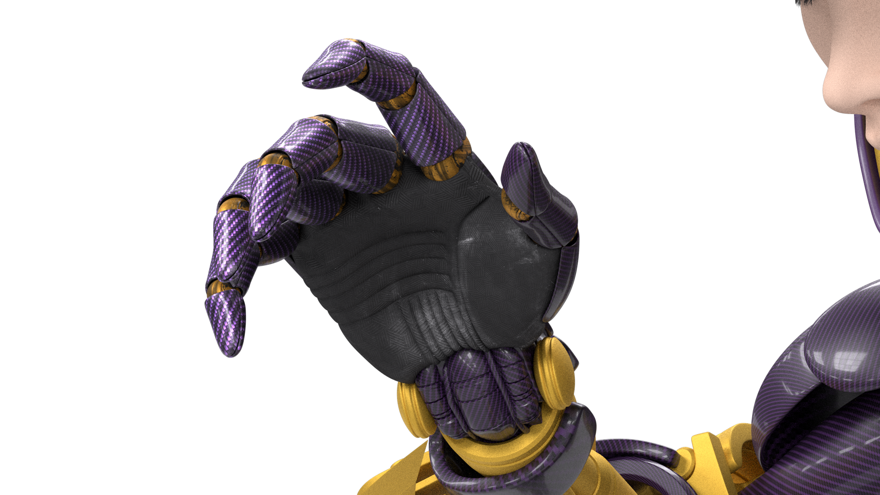
Notes:
And here is another render of the hand, from a different angle.

Slide 13
appleseed
Modern
Interactive
Single pass
Tessellation-free
Flicker-free
Notes:
I want to stress that we’re taking a modern approach to rendering
In fact most renderers are moving in that direction these days
We want to have a continuum between interactive rendering and final frame
Same rendering engine, same settings, just different quality levels
We’re targeting single pass rendering
In particular no prior baking of point clouds or brick maps, no shadow maps...
As far as possible, we’re doing direct ray tracing without pre-tessellating surfaces into triangles, or curves into segments
Again, as far as possible we’re using flicker-free techniques, we’re avoiding biased techniques such as all forms of particle tracing

Slide 14
appleseed
Reliable
Avoid (bad) surprises
Avoid crashes
Avoid regressions
Value correctness
Incremental change = incremental effect
Notes:
We’re trying to make appleseed as reliable as we can. That means:
Avoiding bad surprises
Good in previz = good in final render
Avoiding crashes
Avoiding regressions.
We strongly value correctness
Different algorithms must converge to the same image
Forward path tracing vs. backward path tracing
Path tracing vs. particle methods
We regularly do these checks, and they are part of our test suite

Slide 15
appleseed
Flexible
Avoid arbitrary limitations
Provide tons of public extension points
Maximize programmability
OpenShadingLanguage
Disney’s SeExpr
Full C++ API
Full Python 2.x / 3.x API
Notes:
We’re also commited to flexibility.
Obviously we avoid introducing arbitrary limitations, and there aren’t many (that I’m aware of)
We provide tons of extension points
It’s only a few lines of code to replace a component, or to bypass an entire part of the renderer
We make sure to provide as much programmability as possible
We fully support OSL for shading
We also support SeExpr expressions in a growing number of places
We have full C++ and Python APIs

Slide 16
appleseed
Hackable
Fully open source
Liberal license (MIT) from the start
Everything hosted on GitHub
Development fully in the open
Using only open source or free tools
Welcoming, helpful, mature community
Notes:
Hackability means removing barriers to entry.
Everything we do is 100% open source
All our code is under the MIT license, from the beginning
That means commercial embedding is OK
Everything is hosted on GitHub
Source code for appleseed and all related tools
Issue tracker
Documentation
Wiki
Web site...
We’re only using and relying on open source software
Except Visual Studio on Windows (which is free but not open source)

Slide 17
appleseed
Team & Process
Notes:
I want to quickly highlight the role and contributions of our team members.

Slide 18
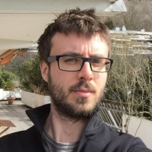
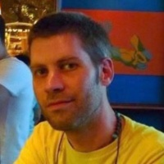
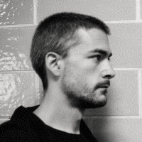
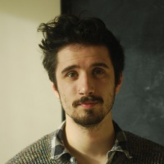
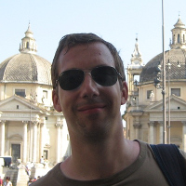
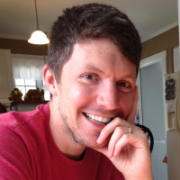
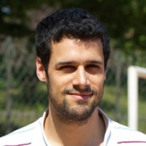
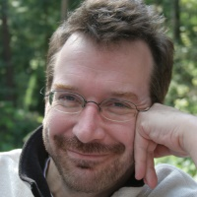
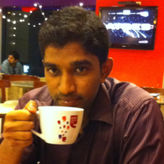
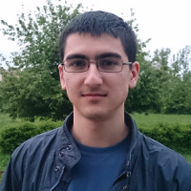
François Beaune
Esteban Tovagliari
François Gilliot
Jonathan Topf
Hans Hoogenboom
Joel Daniels
Dorian Fevrier
Haggi Krey
Srinath Ravichandran
Marius Avram
Notes:
So here are the principal members of the team.

Slide 19
R&D
François Beaune
Esteban Tovagliari
Notes:
At the moment we’re only two developers working on the core renderer.

Slide 20
GSoC ‘14 Students
Srinath Ravichandran
Marius Avram
Notes:
We were fortunate enough to participate to Google Summer of Code last year,
And we had two very talented students that did a really good job
One who worked on curve rendering for hair & fur
One who worked on the material editor in appleseed.studio

Slide 21
Exporters & Integrations
Esteban Tovagliari
Jonathan Topf
Hans Hoogenboom
Joel Daniels
Haggi Krey
Notes:
These guys do a great job at connecting appleseed with DCC apps such as Maya, Blender or Gaffer.

Slide 22
Fetch
François Beaune
François Gilliot
Jonathan Topf
Notes:
And finally this is the team that worked on the short film Fetch about which I’ll talk next.

Slide 23
appleseed
Core practices and values
Collective code ownership
Continuous refactoring
Pull requests reviews
Unit tests
End-to-end tests
Performance regression tests
Notes:
Finally, I want to quickly mention a set of core values and practices that we share, since these have a direct impact on the quality of our work:
Collective code ownership: We’re all allowed to touch or improve all of the code
Continuous refactoring: We keep simplifying and clarifying the code whenever we can
We do friendly but honest reviews of pull requests
PRs are usually good for merging after a couple rounds of reviews and fixes
We do lots of testing, most of it is automated
This allows us to refactor the code while avoiding regressions

Slide 24
appleseed
Selected Works
Notes:
Here are a few recent works done with appleseed.

Slide 25
Light & Dark (BBC Four Documentary)
Notes:
Here’s a short clip from Light & Dark (video).

Slide 26
Light & Dark (BBC Four Documentary)
Notes:
This is a frame from a CG sequence in Light & Dark, one of two documentaries that were made for BBC Four and that aired last year on British TV.

Slide 27
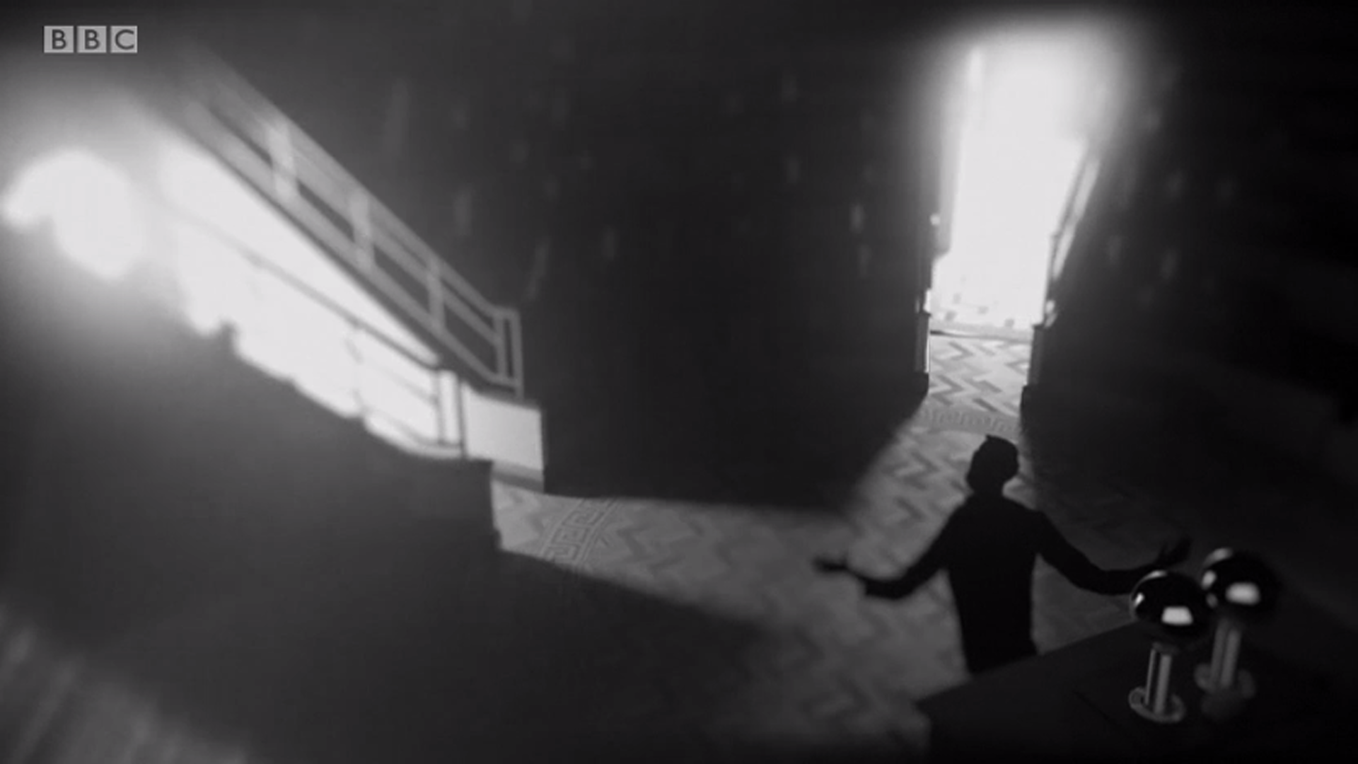
Light & Dark (BBC Four Documentary)
Notes:
Another one.

Slide 28
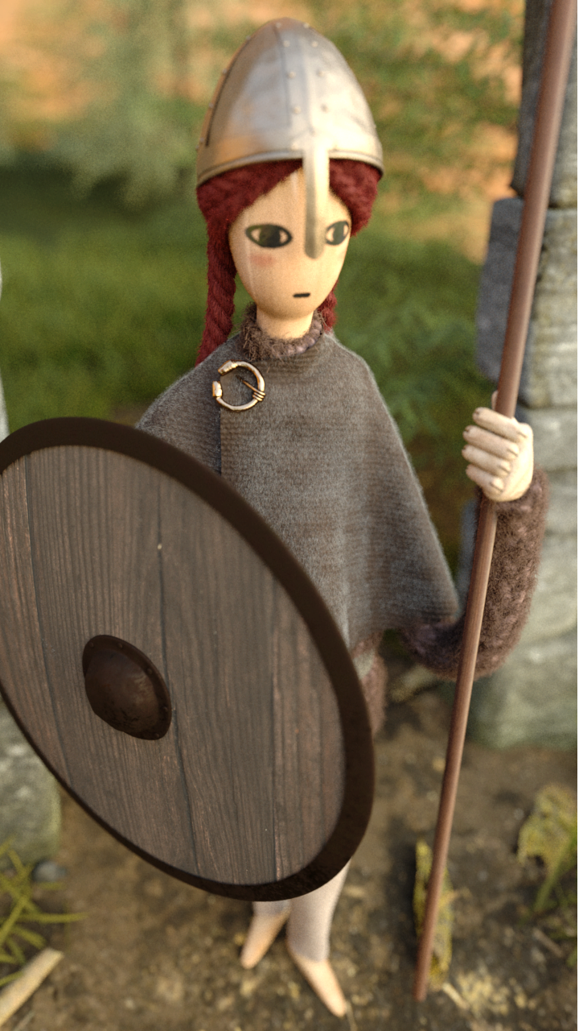
Character designs by appleseed users

Slide 29
Fetch, a very short film
Notes:
This is a frame from Fetch, the short film we’ll talk about next.

Slide 30
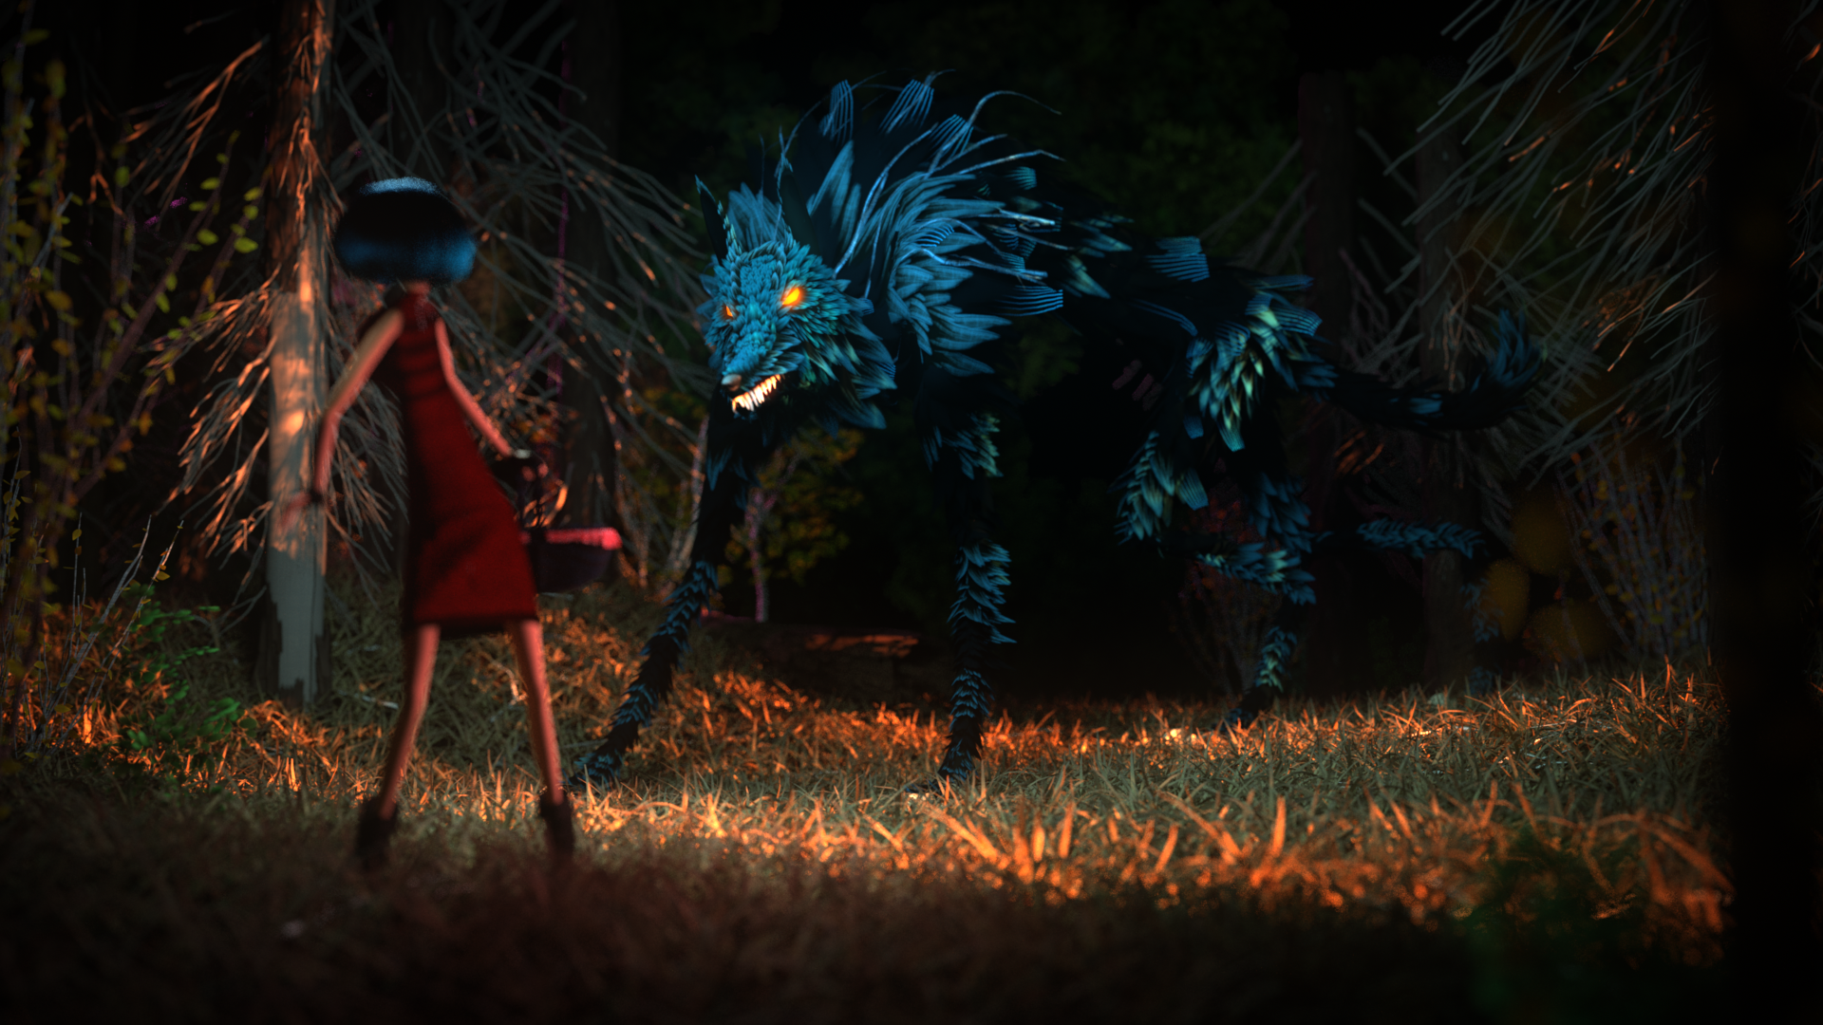
Fetch, a very short film
Notes:
And another one.

Slide 31
appleseed
appleseed now fully integrated into Image Engine’s Gaffer
Notes:
appleseed is now fully integrated into Gaffer
Gaffer is an open source lookdev application by Image Engine
Which is a VFX company based in Vancouver, which worked on Elysium, Zero Dark Thirty, District 9...
This is the result of the phenomenal work by Esteban Tovagliari, in conjunction with John Haddon from Image Engine

Slide 32
Notes:
Here’s a quick demo of appleseed inside Gaffer.

Slide 33
appleseed
Welcoming contributions!
Notes:
We’re welcoming contributions of all kinds!
So if you feel like writing some code, or doing testing, get in touch with us!

Slide 34
appleseed
Home http://appleseedhq.net/
GitHub https://github.com/appleseedhq/appleseed
Development Mailing List https://groups.google.com/forum/#!forum/appleseed-dev Twitter https://twitter.com/appleseedhq
Notes:
I put the principal links on this slide, but you can also just type ‘appleseed renderer’ in Google and you should be good to go.

Slide 35
Making Fetch
Notes:
Alright, let’s move to the second part of this talk: Making the short film Fetch.

Slide 36
Making Fetch
Initiated “Project Mescaline” in June 2012
Goals:
Test & validate appleseed on a small production
Showcase & promote appleseed
Sharpen our skills
Have fun with friends
Constraints:
Final render 100% appleseed
Tiny budget
Notes:
We initiated what we called ‘Project Mescaline’ (I don’t exactly remember why) in June of 2012.
The main goal of this project was to test and validate appleseed on a small production
We also wanted to have some cool material to showcase and promote appleseed
It was also a good occasion to sharpen our skills, and have fun with friends (which we totally did)
We had two main constraints though:
The final render had to be 100% done with appleseed
And we only had a tiny budget.

Slide 37
Making Fetch
Small team:
1 for direction & art
1 for pipeline & render
1 for sound effects & soundtrack (late in project)
Help from friends
Strictly free-time / rainy days project
Effort:
Planned: 8 months
Actual: 19 months ☺
Notes:
As I showed earlier, we were a very small team:
One person (François Gilliot) was responsible for the direction, and for all the graphics arts
One person (me) was responsible for pipeline setup and the final render
And one person (Ulric Santore) was responsible for sound effects and soundtrack
He was only involved at the end of the project, and he did a terrific job
We also got the occasional help from friends, in particular Jonathan Topf for the Maya-to-appleseed exporter
Like appleseed, this was a strictly free-time / rainy days project.
We kind of blew the schedule... But it’s OK ☺

Slide 38
Making Fetch
“Fetch, a very short film”
2 minutes hand-animated short
Targeted at kids
Miniature look
Fully rendered with appleseed
Notes:
So the film is appropriately called ‘Fetch, a very short film’
It’s a 2-minute hand-animated short
Targeted at kids
We went for a miniature look
Definitely inspired by the animated film Coraline, produced by Laika
And of course, as this was the goal, every single pixel was rendered by appleseed

Slide 39
Notes:
(Video)

Slide 40
Making Fetch
Pipeline
Render Setup
Render Farm
Conclusion
Notes:
So I’ll be talking about three technical aspects of the making of Fetch
Our render pipeline
How we did the render setup
And our custom render farm

Slide 41
Making Fetch
Pipeline

Slide 42
Making Fetch – Pipeline
Modeling, animation, lookdev in 3ds Max
Tool of choice for the artist
Lookdev mostly with V-Ray
Integrated in 3ds Max
Notes:
All modeling, animation and lookdev was done in 3ds Max
There wasn’t much discussion about it, it was just the tool of choice of the artist.
Lookdev was mostly done with V-Ray
Again because it’s the tool of choice of the artist
Also because the integration of V-Ray in 3ds Max is solid

Slide 43
Making Fetch – Pipeline
Problem: no 3ds Max-to-appleseed exporter
Writing a full-featured exporter for 3ds Max too big of a project
Solution:
3ds Max
FBX
Maya
appleseed
Notes:
The first problem was of course that, while we had an exporter for Maya (called mayaseed), we didn’t have one for 3ds Max.
We thought we wouldn’t have time to write a full-featured exporter for 3ds Max
On a side note, it turned out we would have had time, and maybe that would have been a wise decision...
Our ‘brilliant’ solution was to rely on Maya for the export, and on the FBX file format for scene data transport...

Slide 44
Making Fetch – Pipeline
Problem: no 3ds Max-to-appleseed exporter
Writing a full-featured exporter for 3ds Max too big of a project
Solution:
3ds Max
FBX
Maya
appleseed
MAXScript
Python
Python
Notes:
Of course, we had to automate a bunch of intermediary tweaks to get it all to work:
In 3ds Max, before the FBX export
In Maya, right after the FBX import
And right after the export to appleseed scene files

Slide 45
Making Fetch – Pipeline
FBX format would lose lots of information
Area lights
Gobos
DOF parameters…
Several custom scripts to remedy this
3ds Max side (MAXScript)
Store various info into custom attributes
Prepare the scene before FBX export
Maya side (Python)
Retrieve info from custom attributes
Adjust materials
Notes:
One of the reason was that the FBX file format is totally not suited for transporting film scenes across DCC apps
It cannot adequately represent
Area lights
Gobos (projection textures on spot lights)
Depth of field parameters...
So the first set of scripts were ran in 3ds Max, before FBX export
They would store as custom attributes everything that cannot be represented by FBX
And generally speaking, they would prepare the set before export
You can see here on the right the UI we built for these scripts
The second set of scripts were ran in Maya, after FBX import
Retrieve the info from custom attributes and apply them to the scene
Adjust materials somewhat

Slide 46
Making Fetch – Pipeline
Initial lookdev mostly with V-Ray 3
Materials translated to appleseed
Automatic translation during export
Lots of post-export tweaks
Automatic tweaks via Python scripts
Notes:
As I explained earlier, the lookdev was done with V-Ray 3
That meant we had to translate V-Ray materials to appleseed
That was mostly done automatically with our pre-FBX and post-FBX scripts
But some more tweaking was necessary after the export to appleseed
A Python script that would directly alter the appleseed scene files (looking for objects and materials by name)

Slide 47
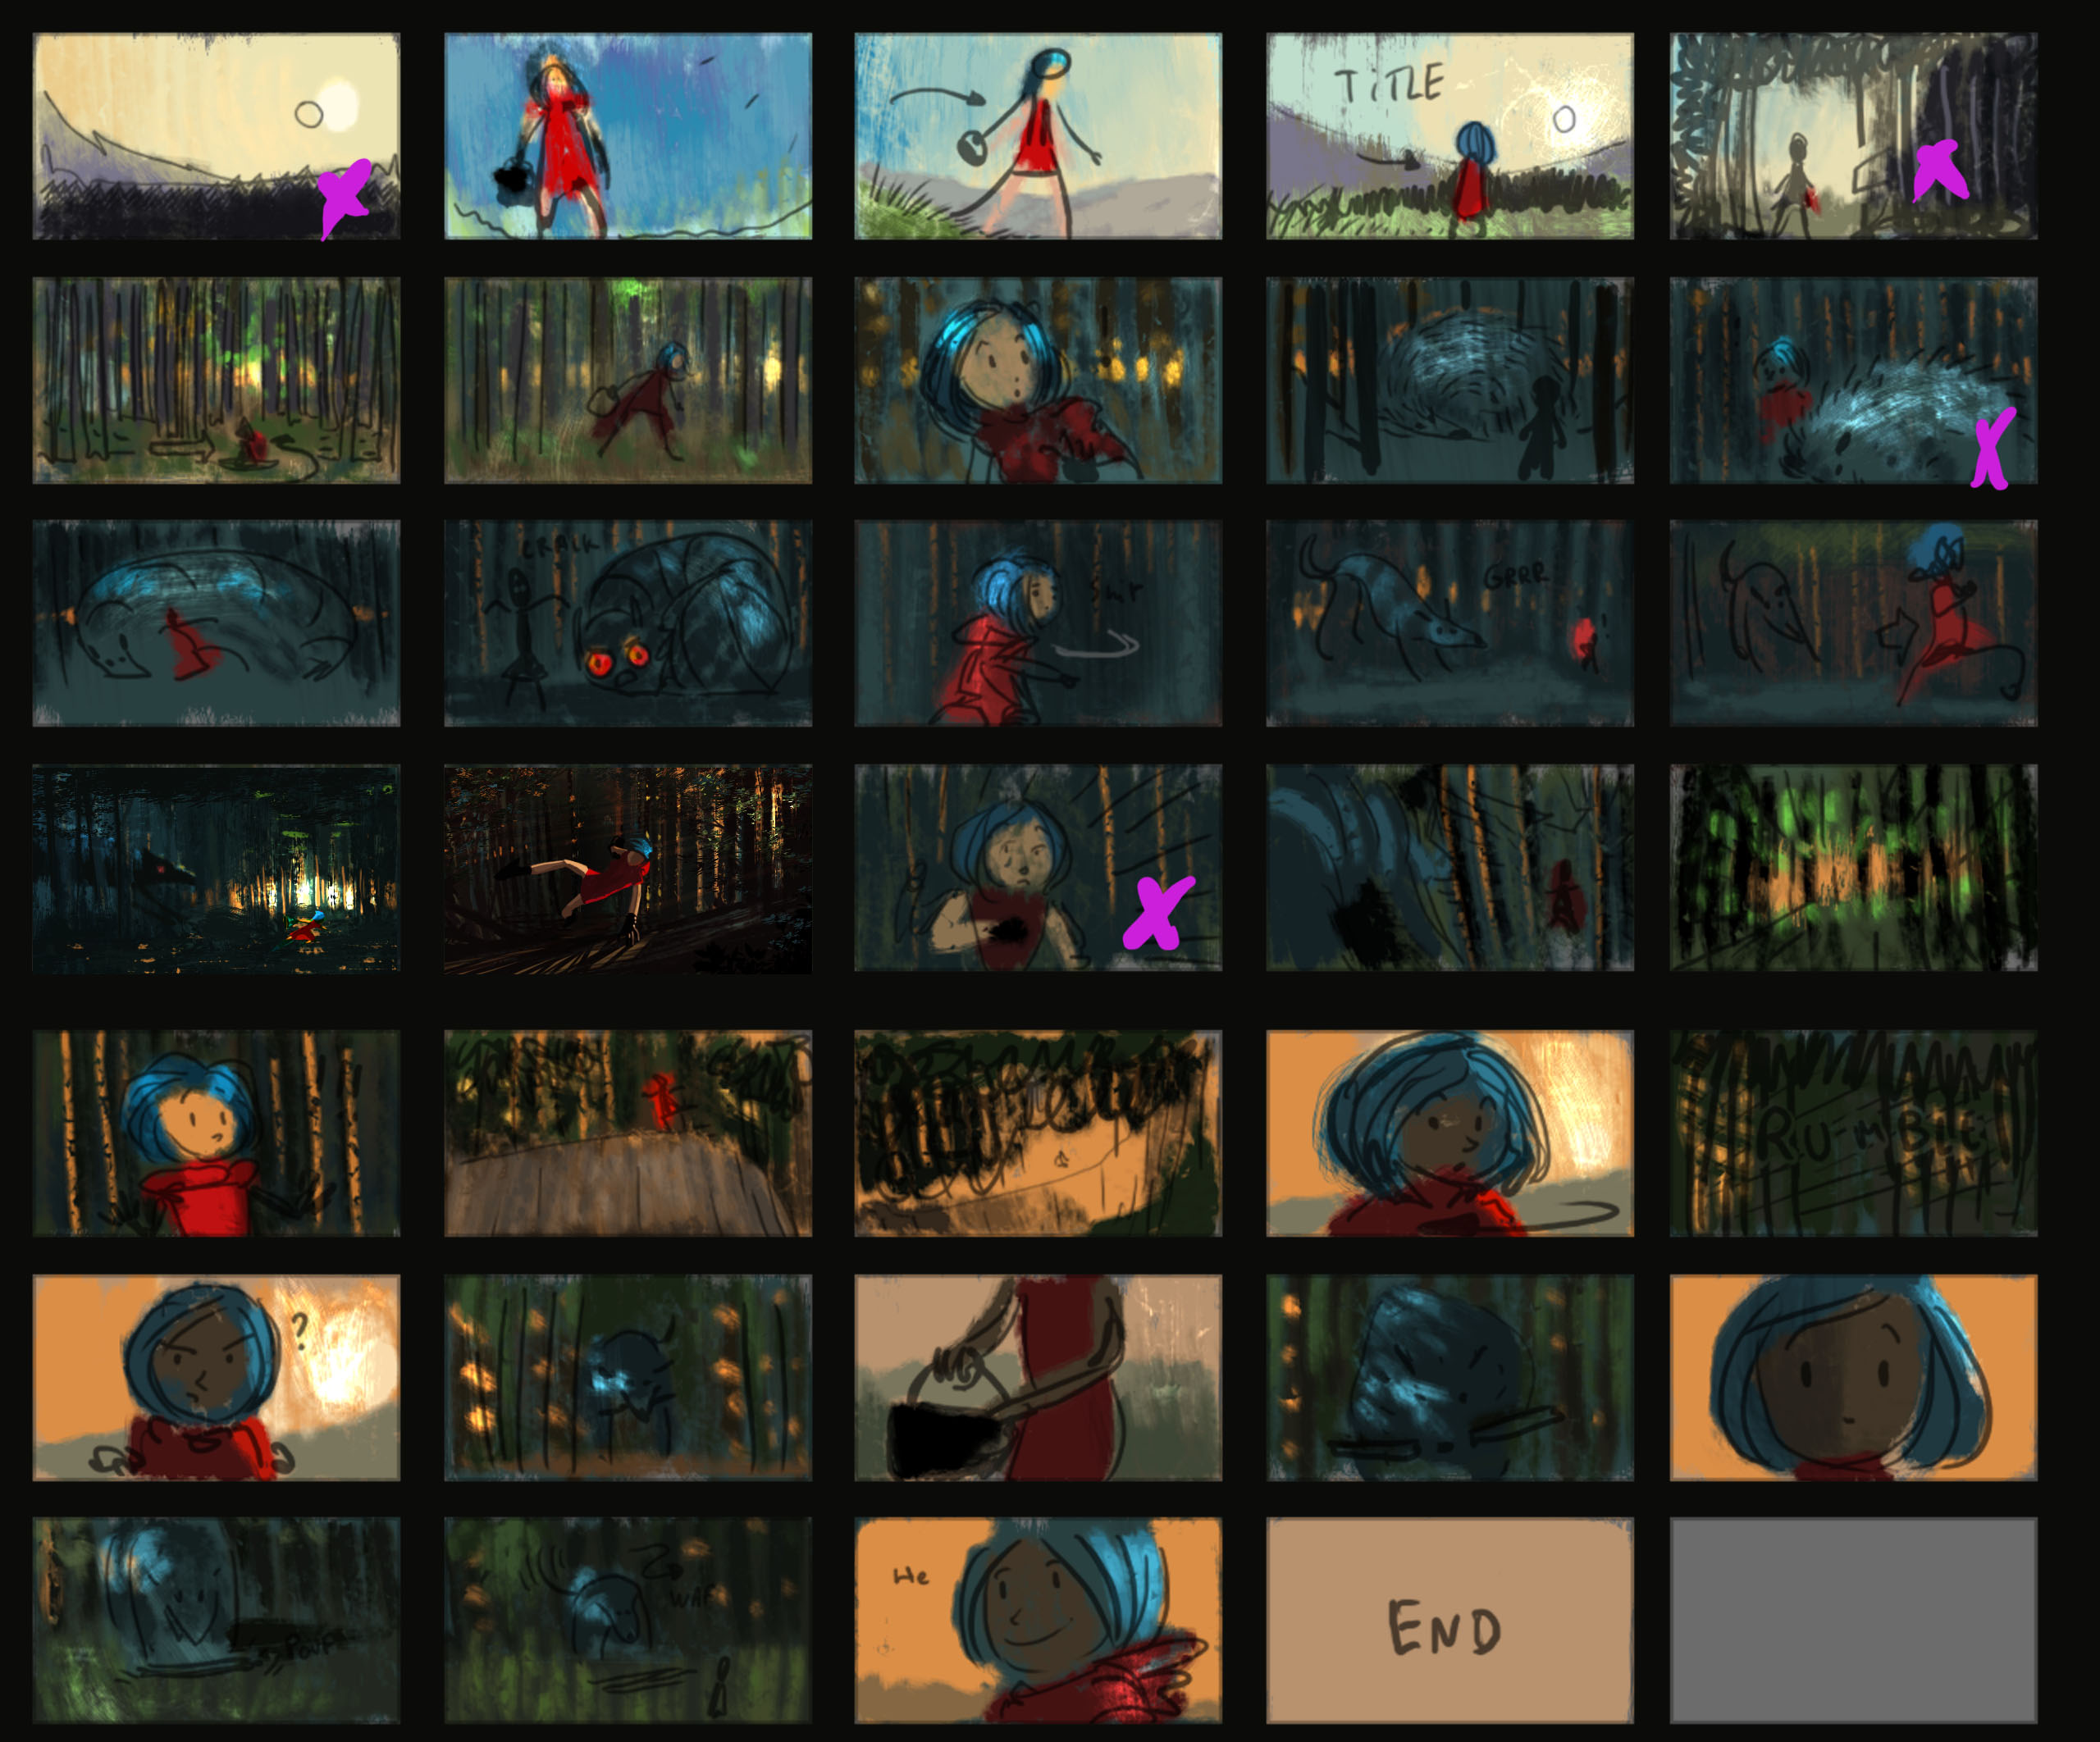
Notes:
Intermezzo: this is the color script of Fetch

Slide 48
Making Fetch
Render Setup
Notes:
Let’s talk now about our render setup...

Slide 49
Making Fetch – Render Setup
Art direction called for:
Miniature look = realistic lighting + shallow DOF
Mostly forest shots with almost no direct illumination
Millions of grass blades and tree leaves in nearly every shot
All translucent (thin translucency)
All using alpha cutouts
Image-based lighting in 25% of the shots
Many scenes with really strong motion
Transformation and deformation
Notes:
Usually, stop motion look means no motion blur
But we wanted to demonstrate appleseed’s motion blur capabilities so we decided to use it nevertheless

Slide 50
Making Fetch – Render Setup
Art direction called for:
Miniature look = realistic lighting + shallow DOF
Mostly forest shots with almost no direct illumination
Millions of grass blades and tree leaves in nearly every shot
All translucent (thin translucency)
All using alpha cutouts
Image-based lighting in 25% of the shots
Many scenes with really strong motion
Transformation and deformation

Slide 51
Making Fetch – Render Setup
Physically-based materials & lighting
Unidirectional path tracing, 2 bounces
64-400 samples/pixel depending on DOF and MB
Single pass, no baking whatsoever
One AOV per light (4-6 lights per shot)
Plus a few special AOVs
Girl’s hair
Wolf’s eyes…
Notes:
So this is how we setup our rendering:
Of course we went for physically-based materials and lighting
Since that’s what would allow us to achieve a miniature look
We limited path tracing to two bounces
Not sure more bounces would have been much slower since most surfaces are rather dark
We used anywhere from 64 to 400 samples/pixel depending on DOF and MB

Slide 52
Making Fetch – Render Setup
Full HD resolution (1920x1080)
24 frames/second
2767 frames (~ 115 seconds)
Notes:
We chose to render at full HD resolution
And we chose 24 frames/second
In hindsight, we could have chosen a lower frame rate, which would have made sense in the stop motion context

Slide 53
Making Fetch – Render Setup
3120 individual scenes to render
2767 frames + a couple backgrounds rendered separately
32 GB of final render data
OpenEXR textures (RLE-compressed)
Proprietary geometry format (LZ4-compressed)
Tens of thousands of files

Slide 54
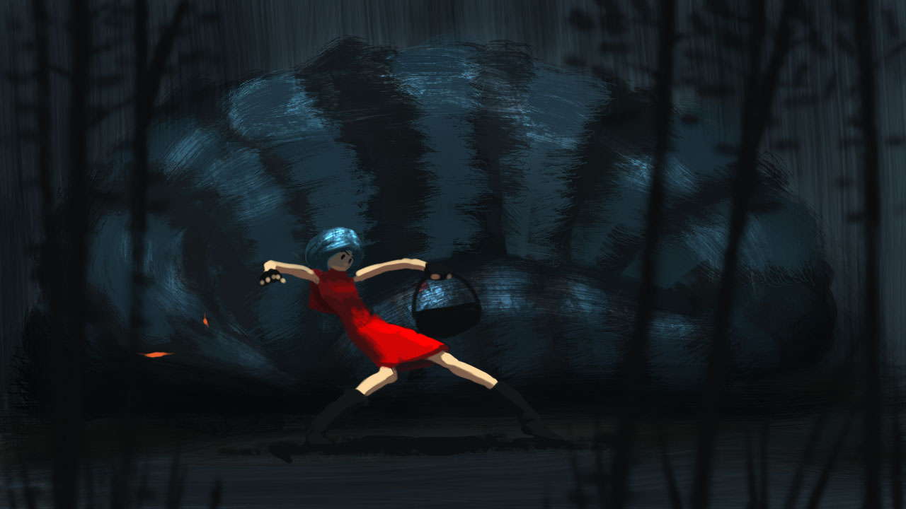
Notes:
Intermezzo: just a drawing

Slide 55
Making Fetch
Render Farm
Notes:
Alright, so let’s talk now about how we actually managed to render that short film...

Slide 56
Making Fetch – Render Farm
Obviously too much work for one or even a couple machines
No money meant:
Not buying additional machines
Not renting a render farm
Not paying for Amazon Web Services
So?
Notes:
Obviously we had way too many frames to render for a single machine, or even a couple of machines
And since we had no money to spare, we couldn’t
Buy additional machines to build our own render farm
Rent a render farm
Build a farm using AWS

Slide 57
Making Fetch – Render Farm
Friends to the rescue!
Challenges:
32 shots, tens of thousands of files, GB of data
Friends all around the place in Europe
Random machines
Random OS
Machines only available occasionally
Many machines behind firewall / NAT
No technical expertise or rendering experience for most of them
Notes:
At this point we decided to involve our friends.
But that brought its own set of challenges.

Slide 58
Making Fetch – Render Farm
Solution: DYI render farm based on Dropbox
Notes:
The solution to this nightmare came in the form of a custom render farm system built around Dropbox
The inspiration for this came from a tiny script that one of our team member, Jonathan Topf, who wrote to render the animations from the Light & Dark documentaries I talked about earlier.

Slide 59
Making Fetch – Render Farm
Use Dropbox as delivery channel, and for command & control
Notes:
The core idea is to use the Dropbox shared directory mechanism:
To deploy appleseed binaries to render node
Reliably send scene data to render nodes
Reliably send rendered frames back to some kind of ‘master’ node

Slide 60
Making Fetch – Render Farm
Kim’s Computer
Render Node
DATA
Shared Dropbox Directory
Thomas’ Computer
Render Node
François’ Computer
Render Manager
Michael’s Computer
Render Node
FRAMES
Shared Dropbox Directory
Notes:
So this is the overall architecture of our system.

Slide 61
Making Fetch – Render Farm
DATA
Shared Dropbox Directory
Shared directory
Assume Dropbox Basic accounts (free!) = 2 GB
Hosts:
appleseed binaries for Windows, Linux and OS X
Data for one or multiple partial shots
Notes:
The central piece is a shared directory we call DATA
Free Dropbox Basic accounts are limited to 2 GB, so that’s the upper limit for the content of this directory.
In this directory we’ll store three things:
appleseed binaries for Windows, Linux and OS X
Shot data (scene files, textures, geometry, etc.)
A few rendered frames
This directory *is* the central delivery and command & control mechanism.
It’s important to note that, regarding shot data, we may have:
multiple different shots at the same time
partial shots (only parts of the frames)

Slide 62
Making Fetch – Render Farm
Shared directory on Dropbox Pro accounts
Hosts all rendered frames
Ended up with 140 GB worth of OpenEXR files
Only shared between team members
FRAMES
Shared Dropbox Directory
Notes:
We also have a second directory we call FRAMES
For this one we assume Dropbox Pro accounts, so limited to 1 TB of data
This directory hosts all the frames renderer so far
We ended up with about 140 GB worth of OpenEXR files
This directory is only shared with team members, not with the render farmers

Slide 63
Making Fetch – Render Farm
A variety of 64-bit machines
Windows Vista, 7, 8
Linux
OS X
Mostly quad core machines
Typically available nights and week-ends
Render nodes run the render node script
Users free to kill render node script at any time
Kim’s Computer
Render Node
Thomas’ Computer
Render Node
Michael’s Computer
Render Node
Notes:
Then we have the Render Nodes themselves
These are just random 64-bit machines running a variety of operating systems
Windows Vista, Windows 7, Windows 8
Linux
OS X
We had mostly quad core machines, but not only
These machines were typically available on nights and week-ends only
Render nodes run a Python script we call the render node script
Acquires render jobs and executes them
Machine owners were free to kill the render node script at any time to reclaim their machine

Slide 64
Making Fetch – Render Farm
Render nodes run a Python script:
Loop:
“Acquire” scene by appending a per-machine suffix to scene file
Render scene
Move rendered frame files to “frames” subdirectory in DATA
Move rendered scene file to “archive” subdirectory in DATA
Notes:
The render node script runs a main loop:
It first ‘acquire’ a random available scene file by appending a per-machine suffix (a short id) to the file
It then render the scene locally
Once done, it moves the rendered frame (up to a dozen OpenEXR files) to a ‘frames’ subdirectory
And finally it moves the scene file to an ‘archive’ subdirectory

Slide 65
Making Fetch – Render Farm
Underpowered Core i5 laptop
Managing rendering:
Upload/remove shot data as required
Honor 2 GB size limitation of DATA at all times
Move rendered frames from DATA to FRAMES
Monitor and print render farm health, activity and progress
Running 24/7
François’ Computer
Render Manager
Notes:
Finally we have the Render Manager, which was just my laptop (my main machine at the time)
Definitely a low-spec machine, certainly too weak for any serious compute task
But enough to manage rendering (and to develop appleseed)
So the tasks of the Render Manager are:
Upload shot data as required
Remove unused shot data to honor the 2 GB size limitation at all times
Move rendered frames from DATA to FRAMES
Monitor and print the render farm health, activity and progress
My machine was running nearly 24/7 at the time
I actually surprised it didn’t kill it

Slide 66
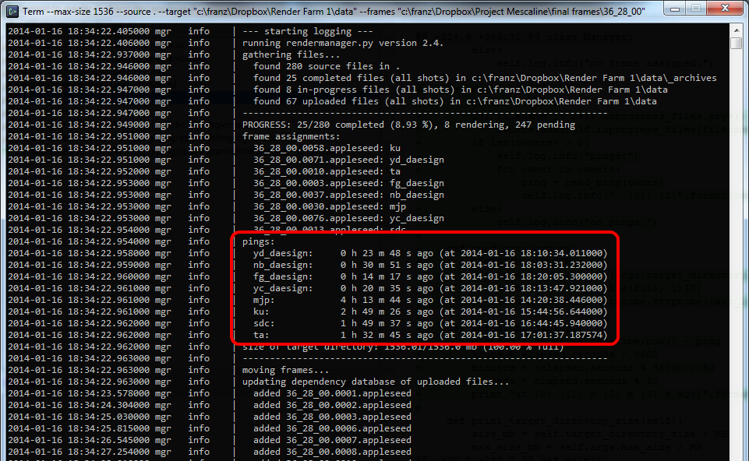
Notes:
Here is a random screenshot I found while making this presentation
Nevermind the red rectangle highlighting the machine pings
I was probably just excited to show this new feature to someone at the time this screenshot was made
So in this picture you can see:
A summary of what the DATA directory contains
Frame files being rendered by machines
Machines are identified by a short id, typically the initials of its owner
Pings, to check when we last got news from a machine
If you’re curious, pings were derived from the ‘Last Modified’ date on the scene files
And then what actions the render manager is taking

Slide 67
Making Fetch – Render Farm
Render Manager Robustness
“Rendering state” fully implicit
Render manager free to start/stop/crash at any time
Notes:
The key to making the render managed robust was to make it state-free
The ‘rendering state’ was entirely determined by the files in DATA
That meant that I could start or stop the render manager without impacting rendering
For instance to fix a bug in the script
If the render manager crashes or stops:
Render nodes simply run out of work
Or the DATA shared directory fills up and nodes no longer gets Dropbox updates

Slide 68
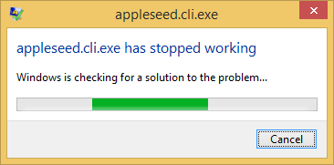
Making Fetch – Render Farm
Render Nodes Robustness
Not all geometry files or textures available to render given scene
On Windows: appleseed crash = Windows Error Reporting Message Box
Notes:
Geometry files or textures could be missing to render a given frame
So the render node scripts has to check if all dependencies are present before rendering
Parse scene file (XML) and extract file names
On Windows, if appleseed crashes, by default a message box opens
That stalls the render node until someone gets in front of the computer to manually close the message box
So the render node script disables Windows Error Reporting on startup (and restores it on exit)

Slide 69
Making Fetch – Render Farm
Advantages
Easy for friends to join & participate
Reliable transport of scene data and rendered frames
Easy to add/remove render nodes
Easy to update new appleseed binaries
Easy to analyze performance and crashes of render nodes
Eventually quite robust

Slide 70
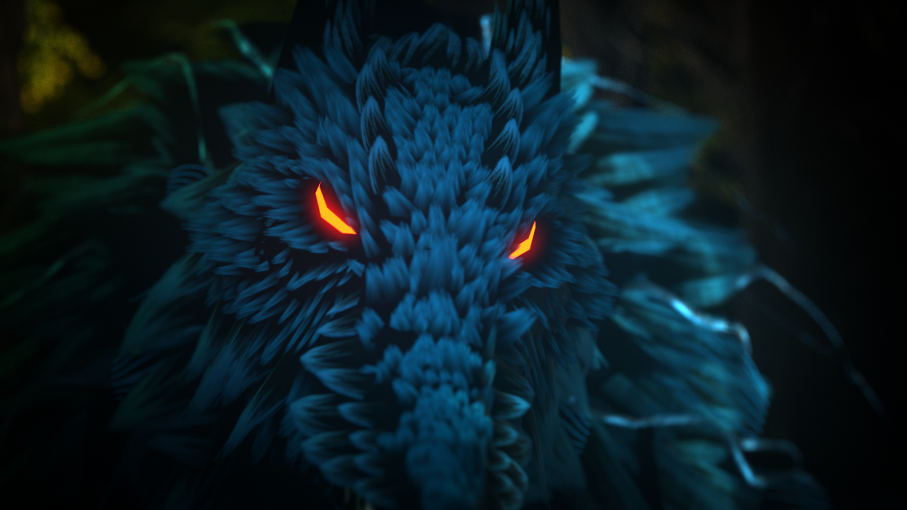
Notes:
Intermezzo: a close-up of the wolf with his curious feather-like fur...

Slide 71
Making Fetch
Conclusion
Notes:
Let’s conclude this section, and the talk.

Slide 72
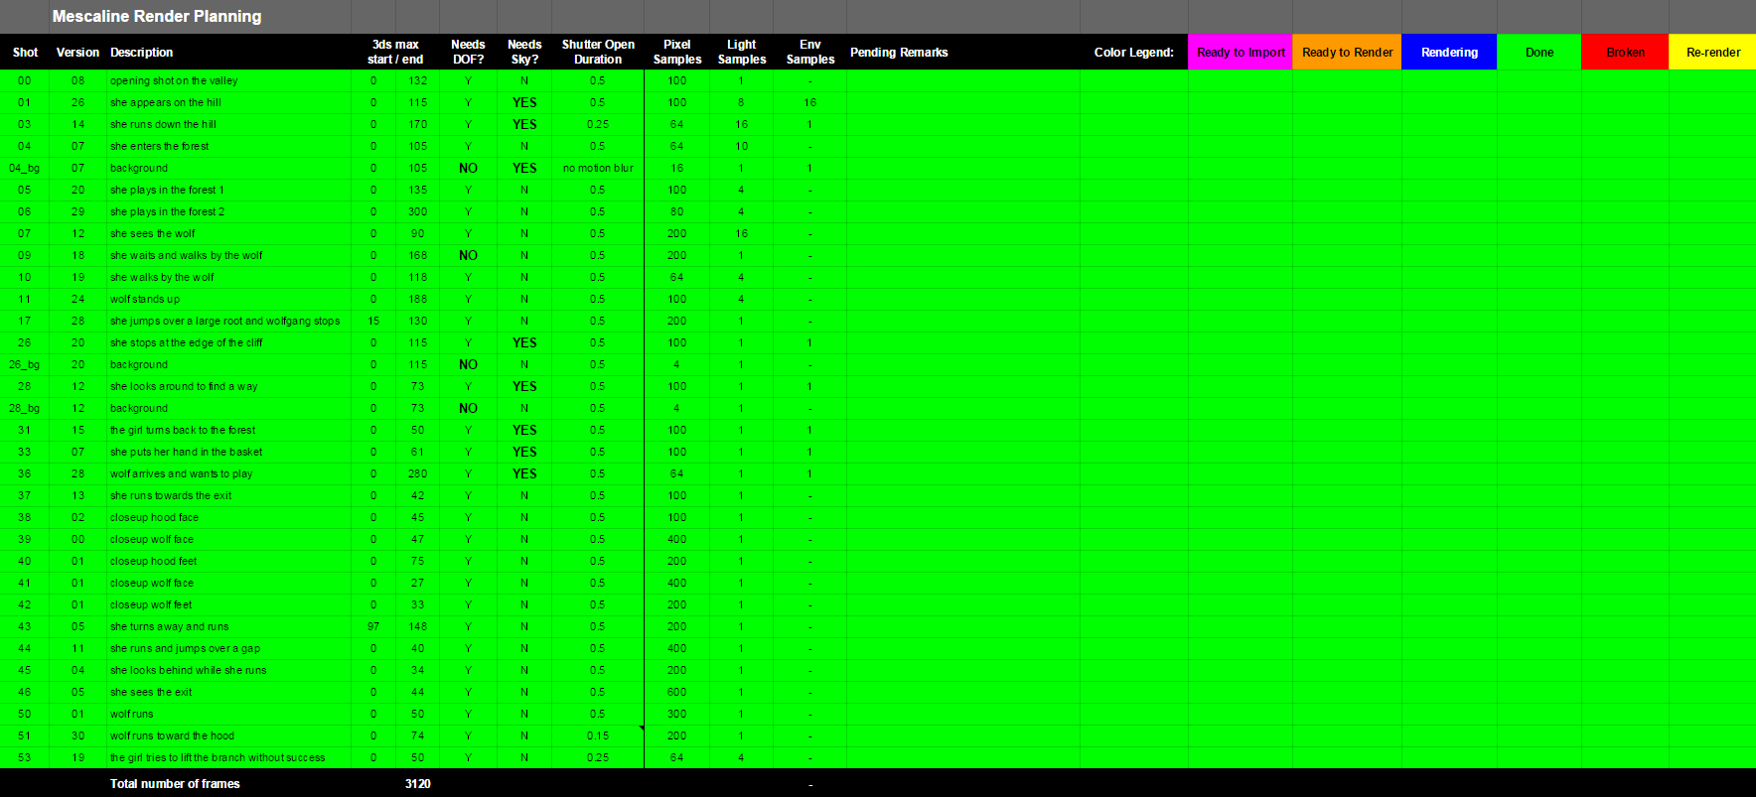
Notes:
It’s hard to say how long rendering eventually took
Since it was mixed up with lots of activities such as preparing shots, exporting them, etc.
A couple weeks seems like a reasonable estimate

Slide 73
Making Fetch – Conclusion
Special developments
Efficient handling of massive number of alpha cutouts
Dropbox-based render farm tools
Vast improvements to Maya-to-appleseed exporter (mayaseed)
Everything has been released
Notes:
Making Fetch led to a few interesting developments:
Very efficient handling of large number of alpha cutouts
The Dropbox-based render farm system we just talked about
And vast improvements to mayaseed, our Maya-to-appleseed translator
Everything that we did for Fetch founds it way into official releases.

Slide 74
Making Fetch – Conclusion
appleseed one of the most reliable component of the pipeline
Did not have to worry about:
Flickering
Glitches in the middle of a shot
Unpredictable catastrophic slowdown
Notes:
Retrospectively, appleseed was certainly one of the most (if not the most) reliable component of the pipeline
We did fix a few important bugs at the very beginning of the project, but after that it was very reliable
Flickering has never been a concern, and we didn’t get any
Similarly, when we did encounter render glitches in the middle of the shot, they were due to a bad scene setup, not due to appleseed
We didn’t suffer from unpredictable performance problems such as catastrophic slowdown...

Slide 75
Making Fetch – Conclusion
Only two questions:
What render settings?
How long will it take?
Notes:
We were basically left with only two questions:
What render settings to use for acceptable noise levels & render times?
How long will the render take for any given shot?

Slide 76
Making Fetch – Conclusion
What would we do differently today?
Export Alembic files from 3ds Max
Lookdev in Gaffer
Real hair?
OSL shaders?

Slide 77
Making Fetch – Conclusion
Published on Vimeo
Picked up by many big animation channels, ended up on YouTube
Great reception on the web
Some really nice articles written about the project

Slide 78
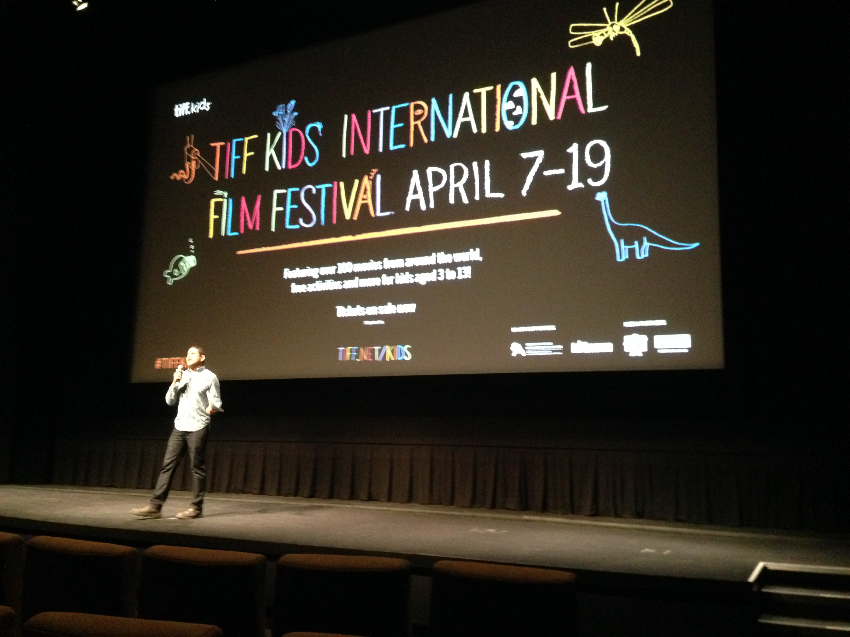
Making Fetch – Conclusion
Official TIFF Kids 2015 selection!
Notes:
We were actually invited to Toronto last month to present the film!

Slide 79
Thank you!

Slide 80
Questions?
Notes:
We’ve got a few minutes, I’ll be happy to answer any question!

Slide 81
Extras
There’s never enough!

Slide 82
Additional References
Direct Ray Tracing of Full-Featured Subdivision Surfaces with Bezier Clipping http://jcgt.org/published/0004/01/04/
Notes:
Direct ray tracing of Catmull-Clark subdivision surfaces by Takahito Tejima et. al. (Pixar)
Intersection of Bézier patches without pre-tessellation
Supports full set of RenderMan and OpenSubdiv features
Hierarchical edits, creases, semi-sharp creases, corners, etc.

Slide 83
appleseed
Many important features still missing
Volume rendering
Subsurface scattering
Subdivision surfaces
Displacement
Robust, complete, performant Maya integration
Documentation

Slide 84
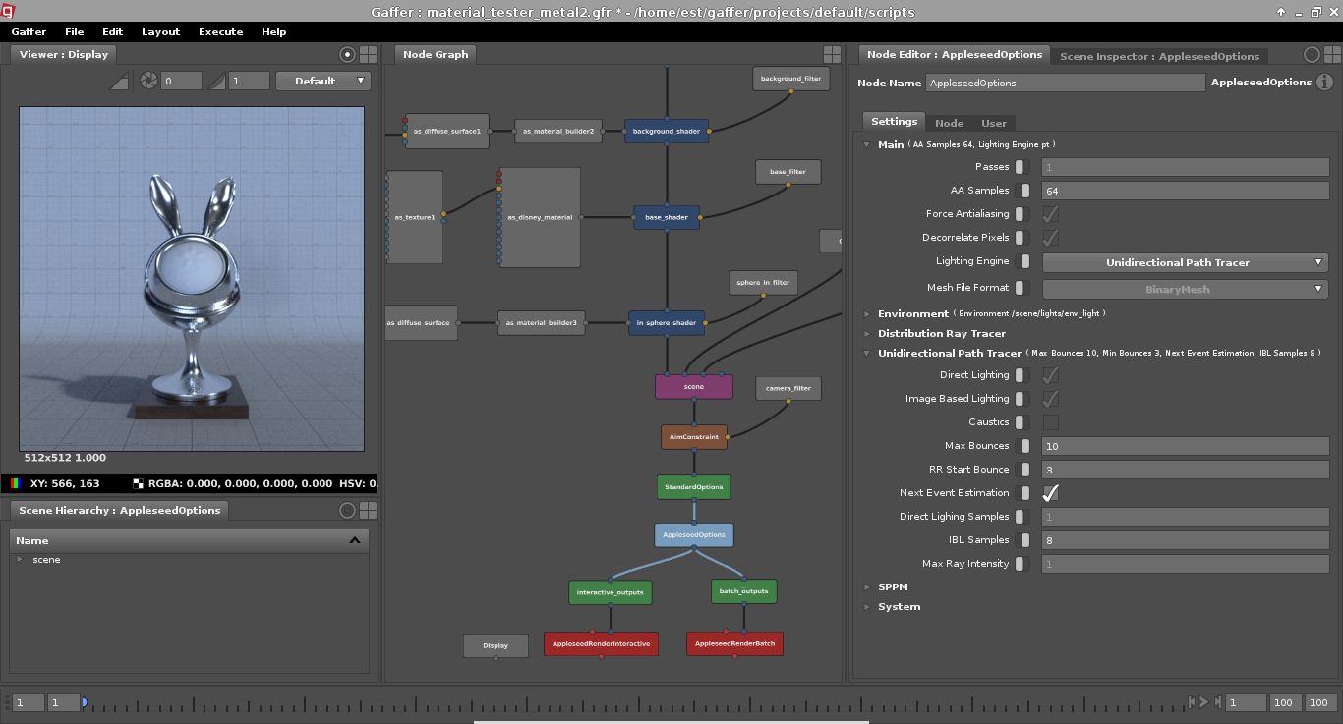
Notes:
Here’s a screenshot of appleseed inside Gaffer.

